Slide 1
Synthesis, biological studies, molecular docking and in silico ADME prediction of novel 1,2,3-triazole-quinazolinone derivatives
Dr. Mir Mohammad Masood
Assistant Professor
email: mirmmasood@gmail.com
Govt. Degree College, Anantnag
Jammu & Kashmir

Slide 2
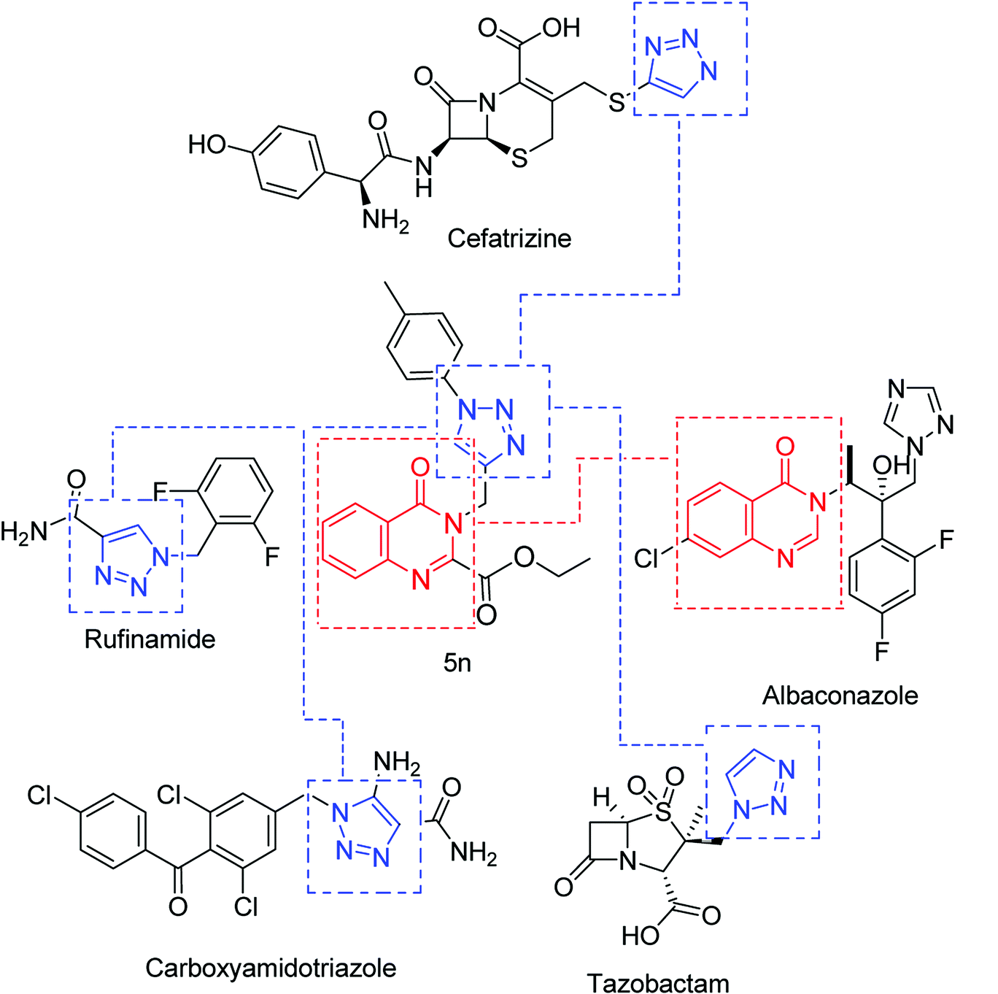
Designing strategy for present work based on available antifungal drugs.

Slide 3
1,2,3-triazoles
Triazoles are heterocyclic compounds with three nitrogen and two carbon atoms in a five-membered ring. Two isomeric forms of triazoles with the molecular formula C₂H₃N₃ exists viz. 1,2,3-triazole and 1,2,4-triazole.

Slide 4
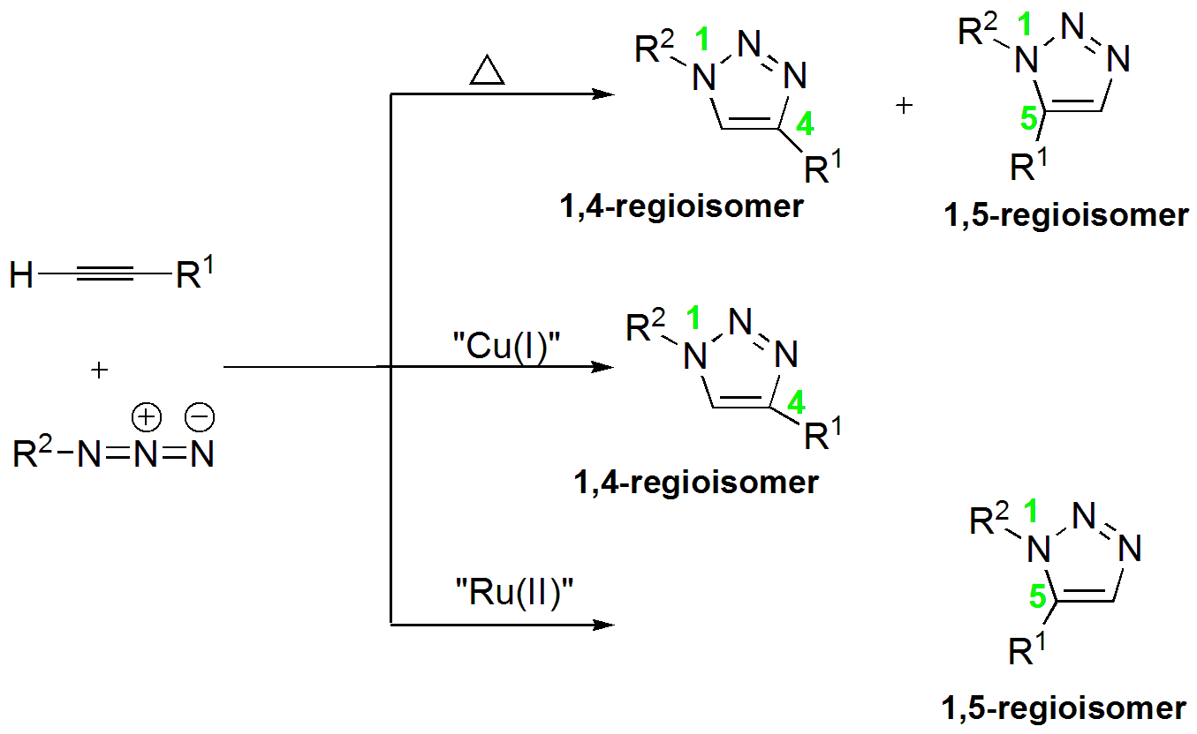
> 92 ˚C
Scheme: Azide-alkyne cycloaddition reactions for the synthesis of 1,2,3-triazole.
The synthesis of 1,2,3-triazole moiety is mainly based upon classical Huisgen 1,3-dipolar cycloaddition under thermal conditions.

Slide 5
Biological Importance of triazoles
Fig: Structure of FDA-approved triazole bearing drugs.

Slide 6
Quinazolinones
Depending upon the position of the keto group, quinazolinones may be classified into three types 2(1H)-quinazolinone, 4(3H)-quinazolinone and 2,4(1H,3H)-quinazolinedione.
The first quinazolinone compound was obtained as early as 1869 from anthranilic acid and cyanogens to give 2-cyanoquinazolinone.

Slide 7
Interest in the medicinal chemistry of quinazolinone derivatives was stimulated in the early 1950s with the elucidation of febrifugine, a quinazolinone alkaloid, effective against malaria.
Meantime (in 1951), in a quest to find out additional potential of quinazolinone-based drugs, methaqualone was synthesized, which was famous for its sedative–hypnotic effects.

Slide 8
Biological Importance of Quinazolinones
Fig: Some natural and synthetic bioactive compounds containing quinazolinone ring.

Slide 9
Synthesis of 1,2,3-tiazole–quinazolinone conjugates.
Scheme:
Reagents and conditions: (a) Reflux (185–186 °C), 5 h, 82%; (b) K₂CO₃, DMF, 0 °C–rt, 3 h, 92%; (c) NaNO₂ in HCl, NaN₃, 0 °C–rt, 2.5 h; (d) CuSO₄.5H₂O, sodium ascorbate, THF:H₂O (1:2), rt, 4–5 h, 90–97%; (e) LiOH.H₂O, THF:H₂O (3:1), rt, 2–3 h, 55–89%.

Slide 10
Structure of 1,2,3-triazole-quinazolinone conjugates (5a-q)
S. No. | Code | R | Mol. Formula | Yield
1 | 5a | H | C₂₀H₁₇N₅O₃ | 92%
2 | 5b | o-Cl | C₂₀H₁₆ClN₅O₃ | 89%
3 | 5c | o-F | C₂₀H₁₆FN₅O₃ | 93%
4 | 5d | o-CH₃ | C₂₁H₁₉N₅O₃ | 88%
5 | 5e | o-OCH₃ | C₂₁H₁₉N₅O₄ | 89%
6 | 5f | o-NO₂ | C₂₀H₁₆N₆O₅ | 91%
7 | 5g | m-Cl | C₂₀H₁₆ClN₅O₃ | 96%

Slide 11
Cont…
S. No | Code | R | Mol. Formula | Yield
8 | 5h | m-F | C₂₀H₁₆FN₅O₃ | 97%
9 | 5i | m-CH₃ | C₂₁H₁₉N₅O₃ | 93%
10 | 5j | m-OCH₃ | C₂₁H₁₉N₅O₄ | 94%
11 | 5k | m-NO₂ | C₂₀H₁₆N₆O₅ | 95%
12 | 5l | p-Cl | C₂₀H₁₆ClN₅O₃ | 94%
13 | 5m | p-F | C₂₀H₁₆FN₅O₃ | 97%
14 | 5n | p-CH₃ | C₂₁H₁₉N₅O₃ | 89%
15 | 5o | p-OCH₃ | C₂₁H₁₉N₅O₄ | 87%
16 | 5p | p-NO₂ | C₂₀H₁₆N₆O₅ | 93%
17 | 5q | p-COOH | C₂₁H₁₇N₅O₅ | 91%

Slide 12
Structure of 1,2,3-triazole-quinazolinone conjugates (6a-q)
S. No. | Code | R | Mol. Formula | Yield
1 | 6a | H | C₁₈H₁₃N₅O₃ | 89%
2 | 6b | o-Cl | C₁₈H₁₂ClN₅O₃ | 81%
3 | 6c | o-F | C₁₈H₁₂FN₅O₃ | 55%
4 | 6d | o-CH₃ | C₁₉H₁₅N₅O₃ | 56%
5 | 6e | o-OCH₃ | C₁₉H₁₅N₅O₄ | 59%
6 | 6f | o-NO₂ | C₁₈H₁₂N₆O₅ | 87%
7 | 6g | m-Cl | C₁₈H₁₂ClN₅O₃ | 78%

Slide 13
Cont…
S. No | Code | R | Mol. Formula | Yield
8 | 6h | m-F | C₁₈H₁₂FN₅O₃ | 56%
9 | 6i | m-CH₃ | C₁₉H₁₅N₅O₃ | 83%
10 | 6j | m-OCH₃ | C₁₉H₁₅N₅O₄ | 76%
11 | 6k | m-NO₂ | C₁₈H₁₂N₆O₅ | 81%
12 | 6l | p-Cl | C₁₈H₁₂ClN₅O₃ | 81%
13 | 6m | p-F | C₁₈H₁₂FN₅O₃ | 72%
14 | 6n | p-CH₃ | C₁₉H₁₅N₅O₃ | 71%
15 | 6o | p-OCH₃ | C₁₉H₁₅N₅O₄ | 85%
16 | 6p | p-NO₂ | C₁₈H₁₂N₆O₅ | 64%
17 | 6q | p-COOH | C₁₉H₁₃N₅O₅ | 65%

Slide 14
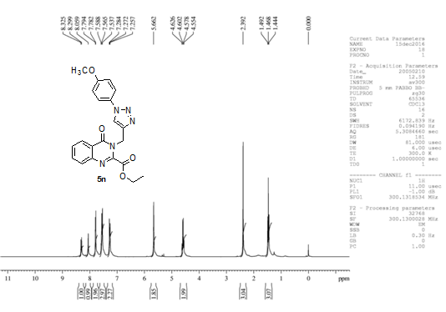
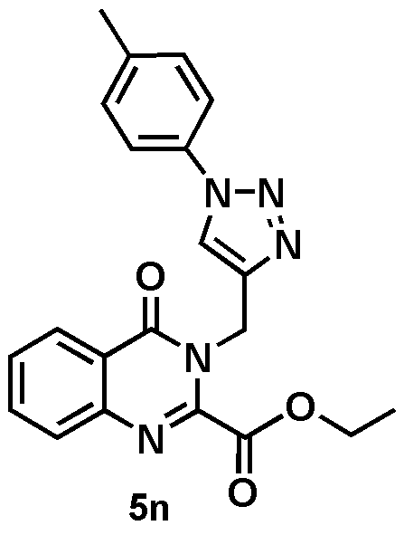
Characterization of synthesized compounds
δ = 2.392 (s,3H, CH₃)
δ = 5.662 (s,2H, CH₂)
δ = 8.059 (s,1H, CH)
¹H NMR spectrum of representative compound 5n

Slide 15
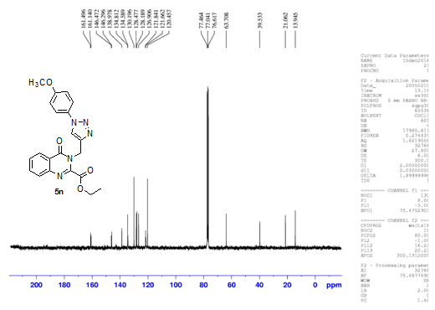
Cont…
¹³C NMR spectrum of representative compound 5n

Slide 16
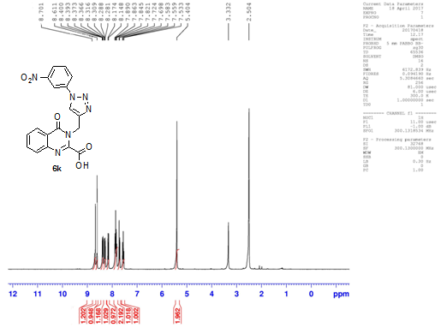
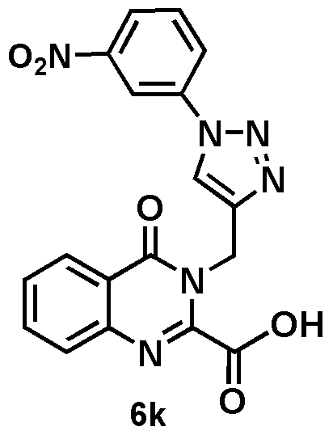
Cont…
δ = 5.404 (s,2H, CH₂)
δ = 8.611 (s,1H, CH)
¹H NMR spectrum of representative compound 6k

Slide 17
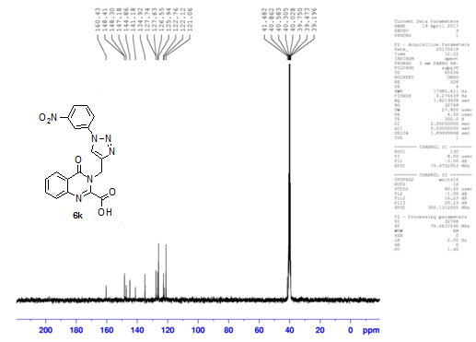
Cont…
¹³C NMR spectrum of representative compound 6k

Slide 18
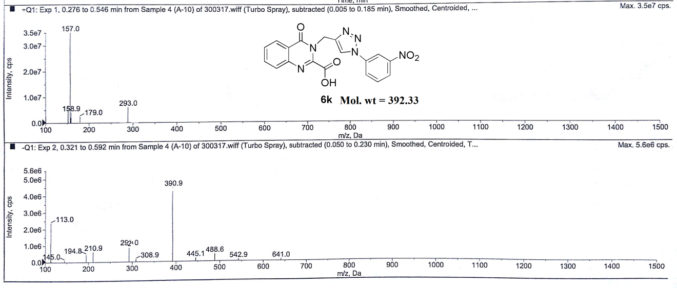
Cont…
LC-MS spectrum of representative compound 6k

Slide 19
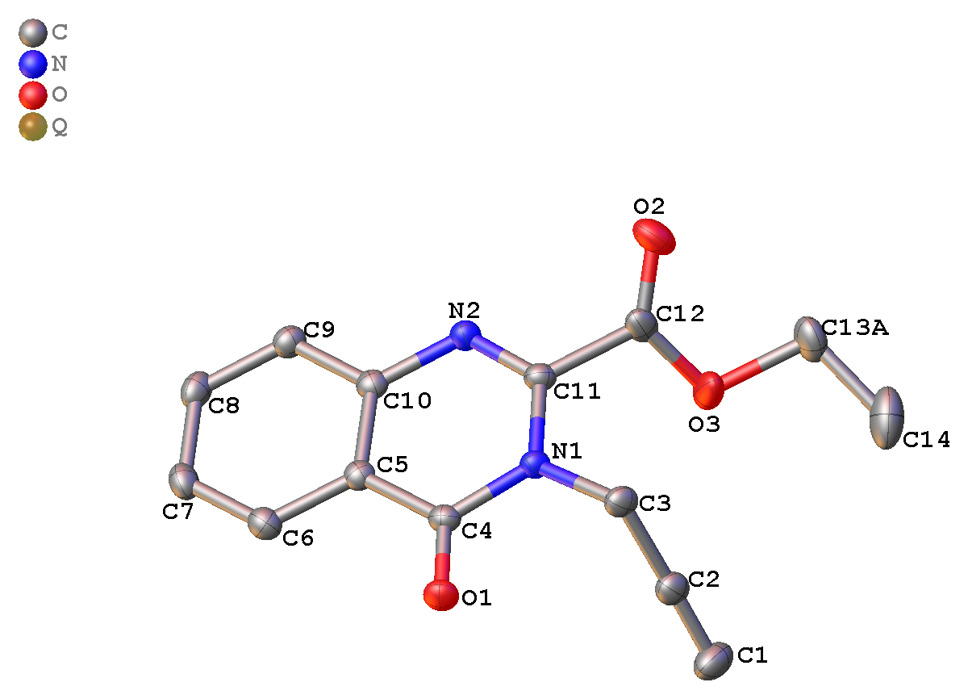
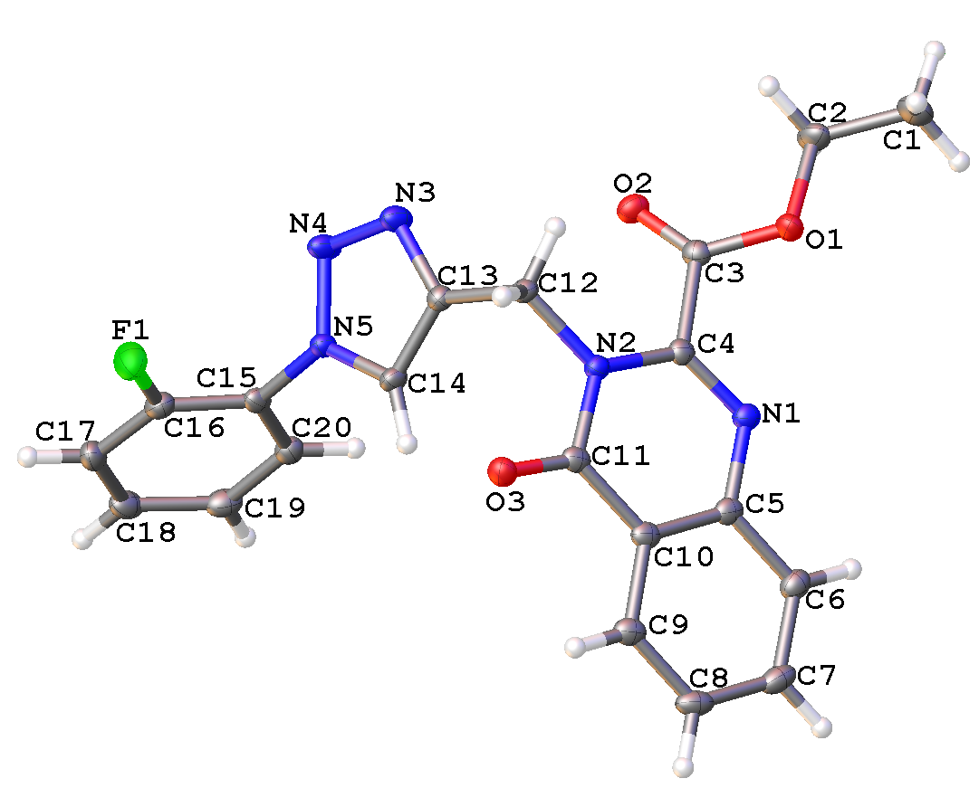
X-ray crystallographic analysis of 2 and 5c
2
5c
Fig: Single crystal X-ray structure of compound 2 & 5c.

Slide 20
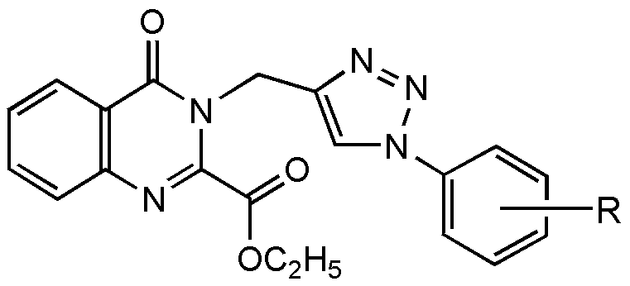
Anticandidal evaluation
Table: In vitro anticandidal activity of compounds (5a–q) against Candida spp.
Compound Code | R | IC₅₀ (mean ± SD)ª µg/mL
 |  | Candida albicans | Candida glabrata | Candida tropicalis
5a | H | 227.71±3.84 | 181.83±7.55 | 74.66±2.13
5b | o-Cl | 124.39±18.43 | 183.45±12.33 | 65.63±4.32
5c | o-F | 109.88±4.76 | 244.66±17.47 | 87.12±2.22
5d | o-CH₃ | 297.22±5.94 | 351.31±6.32 | 190.98±17.23
5e | o-OCH₃ | 18.61±3.42 | 181.80±9.75 | 13.47±2.49
5f | o-NO₂ | 269.41±5.50 | 272.36±4.41 | 238.55±7.12
5g | m-Cl | 65.58±3.20 | 58.17±2.44 | 28.17±2.44
5h | m-F | 509.49±6.41 | 364.85±3.40 | 182.14±11.57

Slide 21
Cont…
Compound Code | R | IC₅₀ (mean ± SD)ª µg/mL
 |  | Candida albicans | Candida glabrata | Candida tropicalis
5i | m-CH₃ | 352.60±11.05 | 395.10±7.46 | 137.11±6.49
5j | m-OCH₃ | 340.48±7.36 | 416.98±2.27 | 113.20±3.67
5k | m-NO₂ | 142.61±2.55 | 354.04±5.43 | 117.02±3.22
5l | p-Cl | 215.55±3.47 | 194.87±3.42 | 249.73±9.68
5m | p-F | 209.26±6.49 | 292.53±9.11 | 434.85±15.46
5n | p-CH₃ | 14.62±2.14 | 8.36±1.31 | 12.37±3.21
5o | p-OCH₃ | 394.29±1.67 | 118.25±6.52 | 441.67±4.28
5p | p-NO₂ | 151.20±15.68 | 315.51±8.93 | 213.77±12.14
5q | p-COOH | 342.30±5.74 | 87.72±5.57 | 290.24±6.74
FLC |  | 15.6±2.23 | 7.8±1.52 | 8.5±1.71

Slide 22
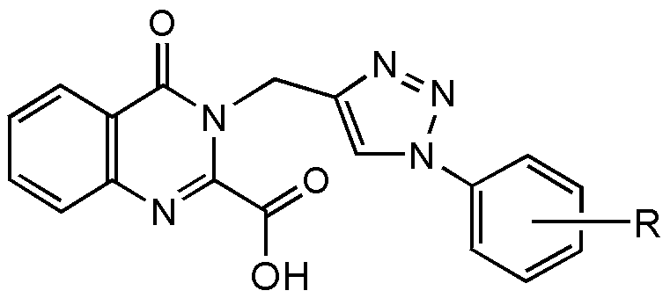
Cont…
Table: In vitro anticandidal activity of compounds (6a–q) against Candida spp.
Compound Code | R | IC₅₀ (mean ± SD)ª µg/mL
 |  | Candida albicans | Candida glabrata | Candida tropicalis
6a | H | 118.74±7.61 | 566.07±9.43 | 184.13±4.82
6b | o-Cl | 168.76±3.38 | 266.46±10.29 | 210.63±13.31
6c | o-F | 100.72±3.67 | 174.36±3.12 | 24.78±2.67
6d | o-CH₃ | 131.17±4.32 | 357.67±6.82 | 233.06±6.88
6e | o-OCH₃ | 48.17±3.17 | 29.38±4.18 | 9.09±2.69
6f | o-NO₂ | 700.85±23.60 | 486.65±18.48 | 520.72±24.12
6g | m-Cl | 100.35±4.02 | 278.14±3.99 | 244.65±2.05
6h | m-F | 134.80±2.37 | 261.89±13.29 | 175.21±3.63

Slide 23
Cont…
Compound Code | R | IC₅₀ (mean ± SD)ª µg/mL
 |  | Candida albicans | Candida glabrata | Candida tropicalis
6i | m-CH₃ | 133.44±4.25 | 244.77±11.23 | 222.80±18.69
6j | m-OCH₃ | 214.35±11.02 | 453.30±13.17 | 444.08±17.37
6k | m-NO₂ | 700.85±23.60 | 486.65±18.48 | 520.72±24.12
6l | p-Cl | 220.89±11.21 | 517.05±18.63 | 303.32±8.50
6m | p-F | 171.92±5.29 | 421.65±15.36 | 231.21±5.71
6n | p-CH₃ | 86.96±4.05 | 288.33±7.37 | 13.54±2.98
6o | p-OCH₃ | 124.87±5.93 | 718.37±13.18 | 162.33±5.24
6p | p-NO₂ | 789.23±16.40 | 432.53±10.31 | 336.61±11.07
6q | p-COOH | 916.32±15.47 | 522.05±4.02 | 457.29±10.70
FLC |  | 15.6±2.23 | 7.8±1.52 | 8.5±1.71

Slide 24
Hemolytic assay
Fig: Hemolytic activity of compounds 5e, 5g, 5n, 6c, 6e and 6n on human RBCs.

Slide 25
Cytotoxic Activity by MTT assay
Figure: Cell viability assay on HEK-293 cell line.

Slide 26
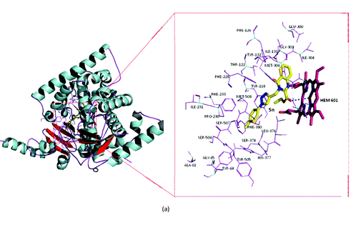
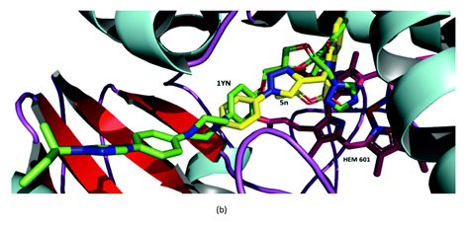
Molecular Docking studies of compounds 5n
Fig. Docking of 5n with lanosterol 14α-demethylase of pathogen C. albicans (PDB: 5v5z): (a) compound 5n (yellow) showing interaction with Heme porphyrin ring (violet) which involves in oxidation process; (b) overlapping image of original inhibitor of protein 1YN (green) and compound 5n within the same binding pocket.

Slide 27
ADME properties
Table: In silico ADME prediction data of the title compounds 5a–q
Compd | MWª | SASA | PSA | NRB | HBD^{b} | HBA^{c} | QP log P o/w^{d} | QP logS^{e} | QP log Khsa^{f} | QP log BB^{g} | VLR5 | %HOA^{h}
5a | 375.38 | 679.855 | 93.977 | 4.00 | 0.00 | 8.00 | 2.790 | -4.260 | -0.293 | -0.783 | 0 | 100
5b | 409.83 | 695.861 | 91.430 | 4.00 | 0.00 | 8.00 | 3.259 | -4.814 | -0.192 | -0.554 | 0 | 100
5c | 393.37 | 685.159 | 92.972 | 4.00 | 0.00 | 8.00 | 2.996 | -4.514 | -0.259 | -0.658 | 0 | 100
5d | 389.41 | 700.262 | 90.193 | 4.00 | 0.00 | 8.00 | 3.131 | -4.647 | -0.158 | -0.660 | 0 | 100
5e | 405.41 | 712.625 | 100.044 | 5.00 | 0.00 | 8.75 | 2.839 | -4.326 | -0.337 | -0.820 | 0 | 100
5f | 420.38 | 708.418 | 130.747 | 5.00 | 0.00 | 9.00 | 2.193 | -4.115 | -0.423 | -1.589 | 1 | 69
5g | 409.83 | 703.976 | 93.977 | 4.00 | 0.00 | 8.00 | 3.296 | -5.030 | -0.164 | -0.630 | 0 | 100
5h | 393.37 | 688.530 | 93.977 | 4.00 | 0.00 | 8.00 | 3.024 | -4.627 | -0.248 | -0.678 | 0 | 100
5i | 389.41 | 712.243 | 93.977 | 4.00 | 0.00 | 8.00 | 3.118 | -4.874 | -0.117 | -0.812 | 0 | 100
5j | 405.41 | 706.853 | 102.995 | 5.00 | 0.00 | 8.75 | 2.761 | -4.217 | -0.355 | -0.853 | 0 | 100
5k | 420.38 | 721.890 | 141.554 | 5.00 | 0.00 | 9.00 | 2.032 | -4.371 | -0.375 | -2.015 | 1 | 62

Slide 28
Cont…
Compd | MWª | SASA | PSA | NRB | HBD^{b} | HBA^{c} | QP log P o/w^{d} | QP logS^{e} | QP log Khsa^{f} | QP log BB^{g} | VLR5 | %HOA^{h}
5l | 409.83 | 703.954 | 93.977 | 4.00 | 0.00 | 8.00 | 3.296 | -5.029 | -0.164 | -0.630 | 0 | 100
5m | 393.37 | 688.516 | 93.977 | 4.00 | 0.00 | 8.00 | 3.024 | -4.627 | -0.248 | -0.678 | 0 | 100
5n | 389.41 | 712.059 | 93.977 | 4.00 | 0.00 | 8.00 | 3.116 | -4.871 | -0.118 | -0.812 | 0 | 95
5o | 405.41 | 715.461 | 102.059 | 5.00 | 0.00 | 8.75 | 2.837 | -4.380 | -0.322 | -0.867 | 0 | 100
5p | 420.38 | 724.784 | 148.449 | 5.00 | 0.00 | 9.00 | 1.910 | -4.425 | -0.332 | -2.330 | 1 | 57
5q | 419.39 | 726.372 | 146.595 | 5.00 | 1.00 | 10.00 | 2.374 | -4.907 | -0.361 | -2.116 | 0 | 65
ªMolecular weight(130.0/725.0), ^{b}No. of H-bond donor groups (0/6), ^{c}No. of H-bond acceptor groups (2/20), ^{d}octanol/water partition coefficient (-2.0/6.5), ^{e}predicted aqueous solubility (-6.5/0.5), ^{f}prediction of binding to human serum albumin (-1.5/1.5), ^{g}predicted brain/blood partition coefficient (-3.0/1.2), ^{h}% Human Oral Absorption in GI (<25% is poor); The values in bracket signify Range for 95% of drugs.

Slide 29
Cont…
Table: In silico ADME prediction data of the title compounds 6a–6q
Compd | MWª | SASA | PSA | NRB | HBD^{b} | HBA^{c} | QP log P o/w^{d} | QP logS^{e} | QP log Khsa^{f} | QP log BB^{g} | VLR5 | %HOA^{h}
6a | 347.33 | 601.932 | 115.398 | 3.00 | 1.00 | 8.00 | 2.312 | -3.874 | -0.382 | -1.279 | 0 | 72
6b | 381.77 | 590.898 | 108.709 | 3.00 | 1.00 | 8.00 | 2.570 | -3.939 | -0.383 | -0.944 | 0 | 76
6c | 365.32 | 580.209 | 110.252 | 3.00 | 1.00 | 8.00 | 2.318 | -3.665 | -0.439 | -1.037 | 0 | 80
6d | 361.36 | 594.823 | 107.471 | 3.00 | 1.00 | 8.00 | 2.437 | -3.755 | -0.353 | -1.052 | 0 | 76
6e | 377.35 | 607.644 | 117.323 | 4.00 | 1.00 | 8.75 | 2.188 | -3.537 | -0.491 | -1.212 | 0 | 73
6f | 392.33 | 603.449 | 148.018 | 4.00 | 1.00 | 9.00 | 1.565 | -3.378 | -0.554 | -1.882 | 1 | 45
6g | 381.77 | 599.023 | 111.256 | 3.00 | 1.00 | 8.00 | 2.599 | -4.137 | -0.363 | -1.017 | 0 | 75
6h | 365.32 | 583.578 | 111.256 | 3.00 | 1.00 | 8.00 | 2.343 | -3.770 | -0.431 | -1.055 | 0 | 74
6i | 361.36 | 607.289 | 111.256 | 3.00 | 1.00 | 8.00 | 2.413 | -3.963 | -0.324 | -1.204 | 0 | 74
6j | 377.35 | 603.714 | 120.269 | 4.00 | 1.00 | 8.75 | 2.153 | -3.472 | -0.489 | -1.228 | 0 | 73
6k | 392.33 | 616.936 | 158.832 | 4.00 | 1.00 | 9.00 | 1.390 | -3.601 | -0.520 | -2.278 | 1 | 38

Slide 30
Cont…
Compd | MWª | SASA | PSA | NRB | HBD^{b} | HBA^{c} | QP log P o/w^{d} | QP logS^{e} | QP log Khsa^{f} | QP log BB^{g} | VLR5 | %HOA^{h}
6l | 381.77 | 599.141 | 111.256 | 3.00 | 1.00 | 8.00 | 2.600 | -4.140 | -0.363 | -1.017 | 0 | 75
6m | 365.32 | 583.575 | 111.256 | 3.00 | 1.00 | 8.00 | 2.342 | -3.770 | -0.431 | -1.055 | 0 | 74
6n | 361.35 | 607.274 | 111.256 | 3.00 | 1.00 | 8.00 | 2.413 | -3.963 | -0.324 | -1.204 | 0 | 74
6o | 377.35 | 611.874 | 118.940 | 4.00 | 1.00 | 8.75 | 2.200 | -3.607 | -0.472 | -1.257 | 0 | 73
6p | 392.33 | 618.820 | 159.698 | 4.00 | 1.00 | 9.00 | 1.393 | -3.632 | -0.513 | -2.305 | 1 | 37
6q | 391.34 | 619.932 | 161.935 | 4.00 | 2.00 | 10.00 | 1.497 | -3.555 | -0.756 | -2.324 | 0 | 40
ªMolecular weight(130.0/725.0), ^{b}No. of H-bond donor groups (0/6), ^{c}No. of H-bond acceptor groups (2/20), ^{d}octanol/water partition coefficient (-2.0/6.5), ^{e}predicted aqueous solubility (-6.5/0.5), ^{f}prediction of binding to human serum albumin (-1.5/1.5), ^{g}predicted brain/blood partition coefficient (-3.0/1.2), ^{h}% Human Oral Absorption in GI (<25% is poor); The values in bracket signify Range for 95% of drugs.

Slide 31
Conclusion
A novel series of 1,2,3-triazole–quinazolinone conjugates (5a–5q) and (6a–6q) were prepared and evaluated for anticandidal activity.
All the synthesised compounds were characterized by IR, ¹H, ¹³C NMR, mass spectroscopic techniques and elemental analysis.
The in vitro anticandidal results show that all the synthesized compounds possess anticandidal activity to certain extent. The compounds 5g, 5n and 6e show good activity against all the three strains of Candida, viz. C. albicans, C. glabrata and C. tropicalis.
The compound 5n emerged as a most potent inhibitor among compounds (5a–5q) and 6e among compounds (6a–6q). Docking studies of compound 5n showed good binding affinity with CYP51 enzyme of C. albicans (PDB: 5v5z).
The hemolysis and cytotoxicity results of compounds 5e, 5g, 5n, 6c, 6e and 6n revealed non-toxic nature of these compounds. In silico ADME prediction of synthesized compounds indicated that compounds have a potential to develop as good oral drug candidate.

Slide 32
Thank You

